Slide 1


SPEECH EMOTION RECOGNITION USING ML
DATA 606 : CAPSTONE IN DATA SCIENCE
Guided By: Prof. Ozgur Ozturk

Slide 2

Our team
SAI SARAN
s157@umbc.edu
SHAH BANSARI
zh92730@umbc.edu
SASHIDHAR GUTHI
ij43577@umbc.edu

Slide 3
OVERVIEW
Speech Emotion Recognition (SER), as the name indicates, is a tool for determining
the emotions present in various audio samples.
In a variety of audio recordings, including job interviews, caller-agent conversations, streaming movies, and music, speech emotion recognition is utilized to determine the emotional spectrum or sentimental value.
Even music classification or recommendation systems can group songs according to their mood and provide tailored playlists to the consumer.
It is probable to infer that a SER component aids with music suggestions in the
intricate algorithms of Spotify and YouTube.

Slide 4
Table of contents
01
02
DATASET DESCRIPTION
OBJECTIVE
03
04
RESULT ANALYSIS & EVALUATION
WORKFLOW

Slide 5

OBJECTIVE
To build a machine learning model that recognize emotion from speech using the librosa
package, sklearn libraries along with four datasets.
To present a classification models for predicting emotions elicited by speeches based on CNN, MLPC, SVM, Logistic Regression, Decision Tree classification by using acoustic features.
The machine learning model has been trained to classify eight different emotions.

Slide 6
How Business Incorporates SER?
Fosters customization with clients by utilizing the SER algorithm to identify their emotions.
Calls are routed based on the client's feelings. An unhappy caller can have their call forwarded to the retention team.
Automotive is the other domain where emotion recognition is in high demand due to its role in providing riders with a satisfying driving experience.
Delivering business-level analytics that makes recommendations based on
customer’s emotions for choosing between different products.

Slide 7

Business Applications of SER
Market research
Customer reaction to new products
Recruitment
Screening of Candidates
Healthcare Robots
Caregiver Robots,
Emotional Counseling
IoT (Internet of Things)/smart devices
Devices responding to emotions.

Slide 8
DATASET DESCRIPTION
Audio Format: .wav Audio Length: 1-3 secs. Data Size: 1.6 GB Training : 70% Testing 30%
Crowd-sourced Emotional Multimodal Actors Dataset (Crema)
Ryerson Audio-Visual Database of Emotional Speech and Song (Ravdess)
Toronto emotional speech set (Tess)
Surrey Audio-Visual Expressed Emotion (Savee)

Slide 9
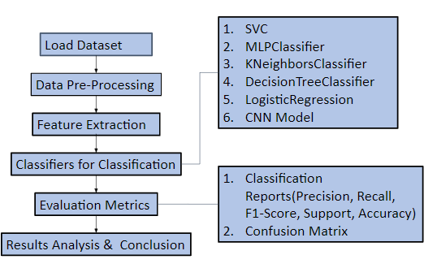
WORKFLOW

Slide 10
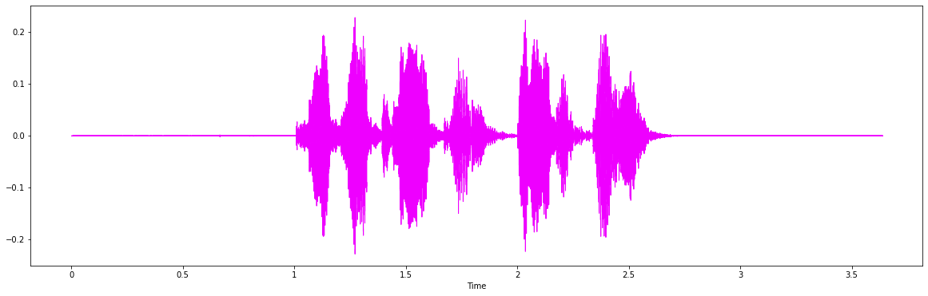
DATA AUGMENTATION
To cope up with the real-world scenarios, adding noise, pitch, stretching and shifting
the audio files helps to identify the emotion more clearly from the dataset.
WAVEPLOT FOR ORIGINAL AUDIO

Slide 11
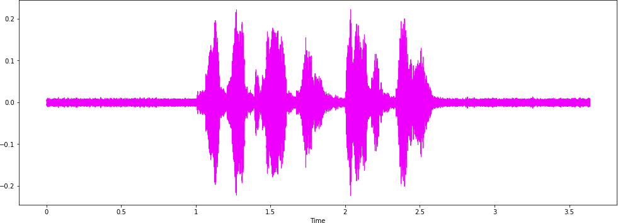
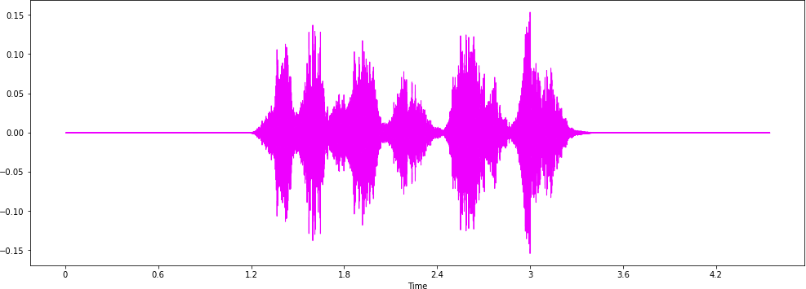
DATA AUGMENTATION CONT..
WAVEPLOT FOR ADDING NOISE TO ORIGINAL AUDIO
WAVEPLOT FOR ADDING STRETCH TO ORIGINAL AUDIO

Slide 12
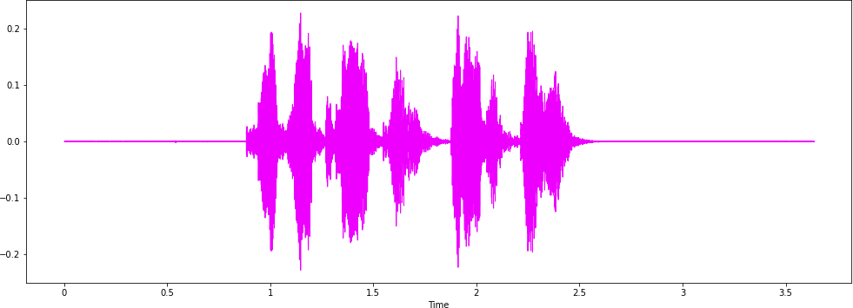
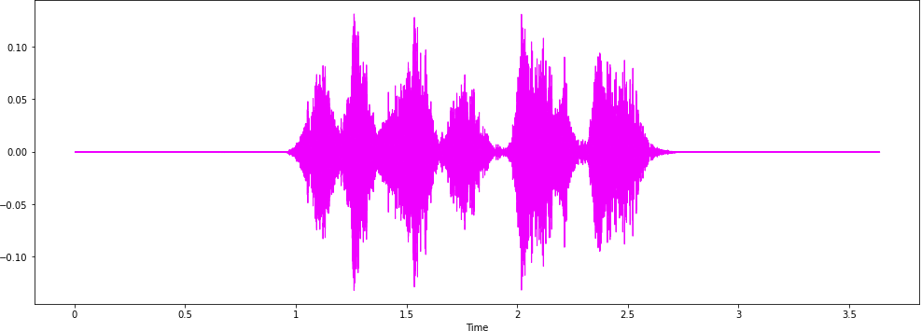
DATA AUGMENTATION CONT..
WAVEPLOT FOR ADDING SHIFTING TO ORIGINAL AUDIO
WAVEPLOT FOR ADDING PITCHTO ORIGINAL AUDIO

Slide 13








DATA PREPROCESSING
COMBING DATA FROM ALL THE FOUR DATASETS.
EXTRACTING EMOTIONS
FROM EACH DATA FILE.
PASSING THE DATA FILES FURTHER FOR FEATURE EXTRACTION.

Slide 14
Tools Used for Audio Processing
LIBROSA PACKAGE | Librosa library can be used in Python to process and extract features from the audio files. “Librosa” is a python package for music and audio analysis. It provides the building blocks necessary to create music information retrieval systems.
FEATURE EXTRACTION TECHNIQUES | MFCC ROOT-MEAN-SQUARE ZERO CROSSING RATE TONNETZ

Slide 15
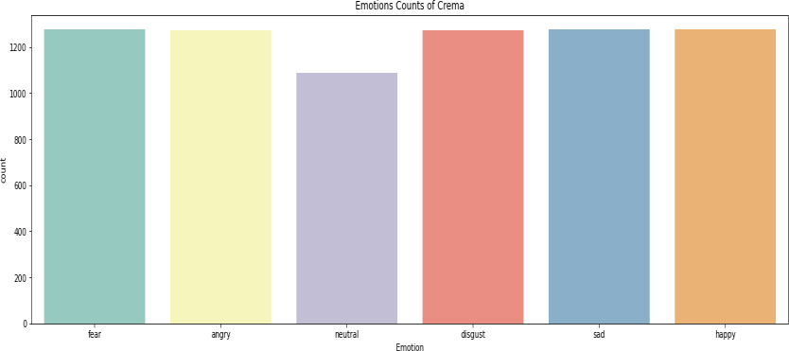
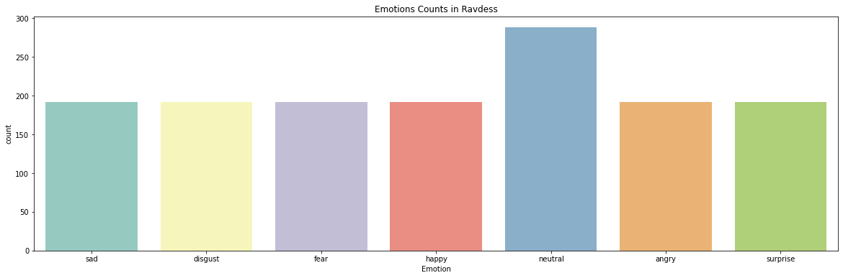
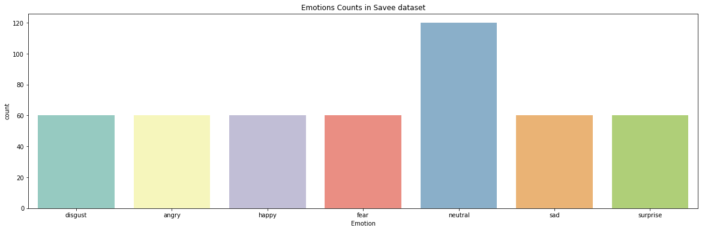
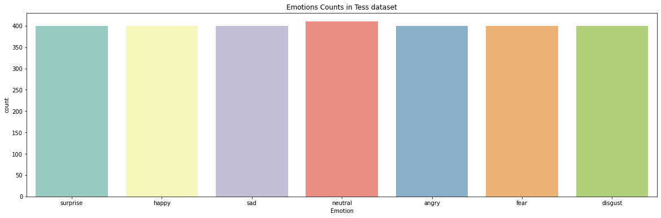
EDA – PART 1
Emotion Counts for Each Dataset

Slide 16
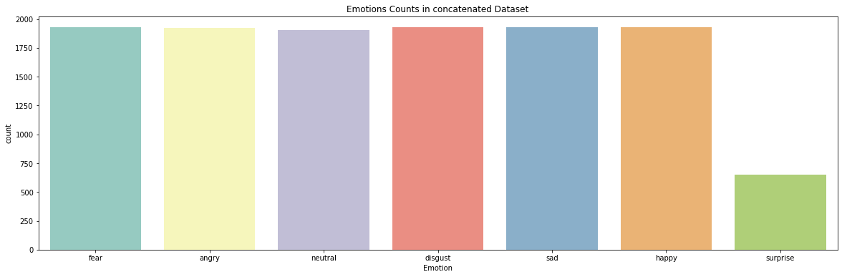
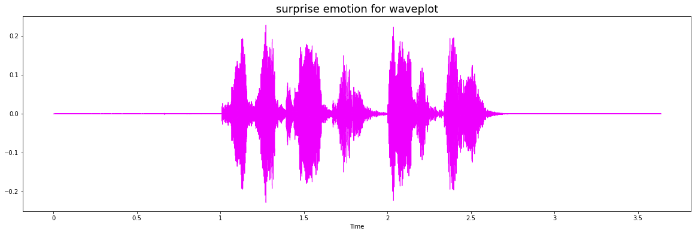
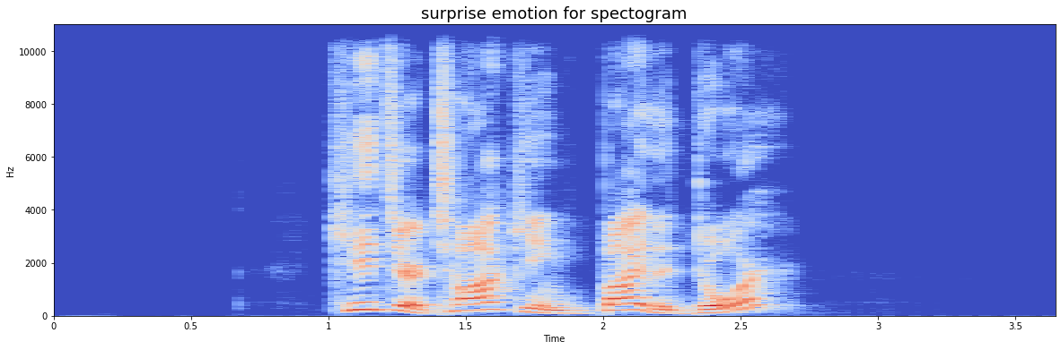
EDA – PART 2

Slide 17
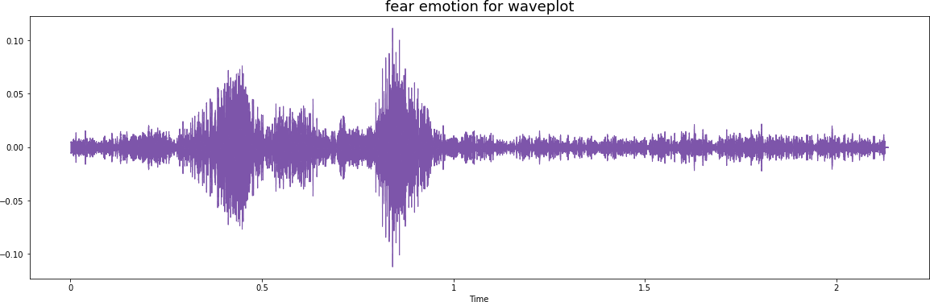
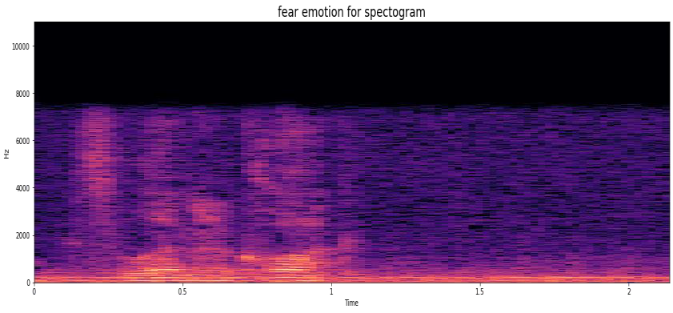
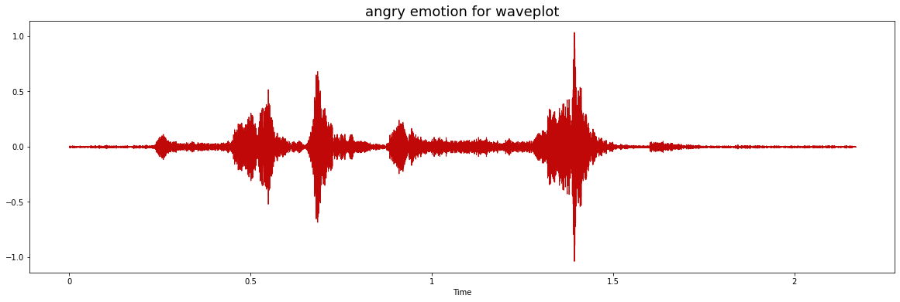
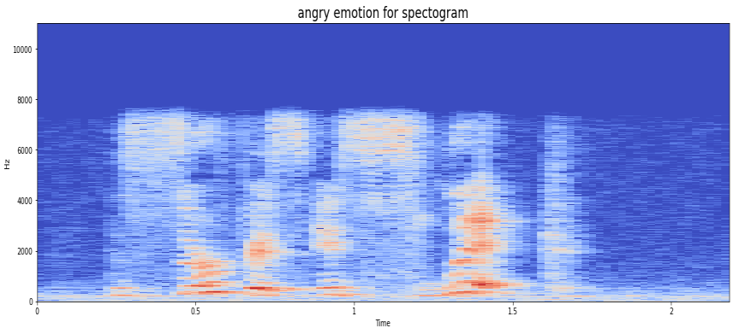
EDA – PART 3
WAVEPLOT AND SPECTOGRAM FOR EACH EMOTION

Slide 18
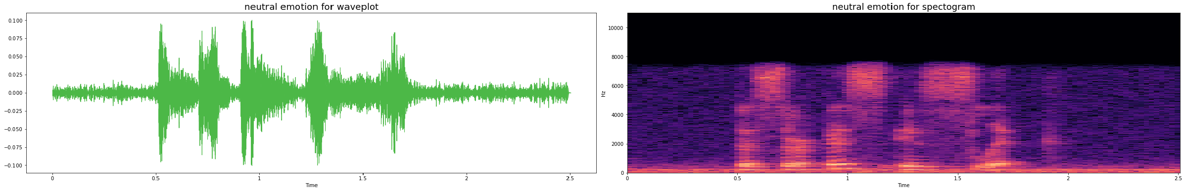
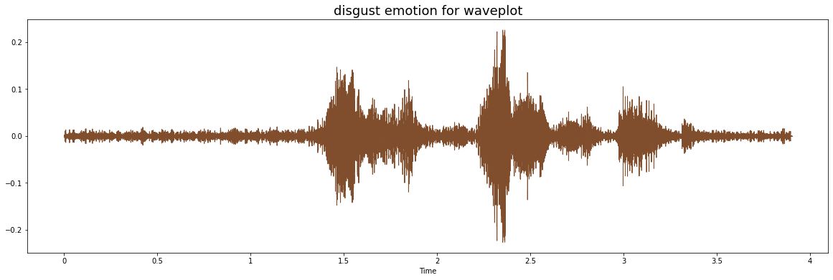
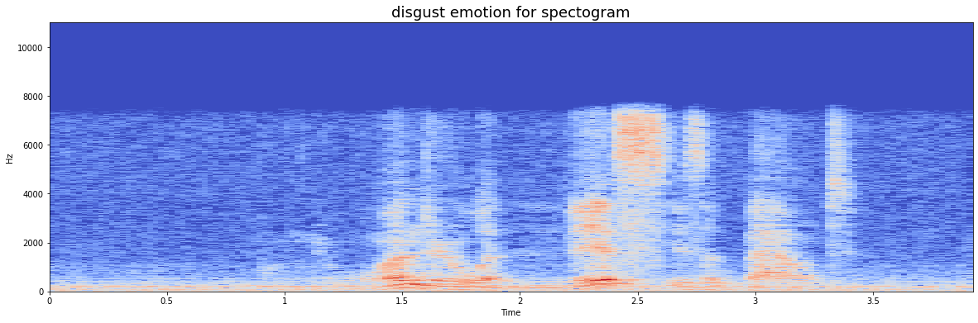
EDA – PART 4
WAVEPLOT AND SPECTOGRAM FOR EACH EMOTION

Slide 19
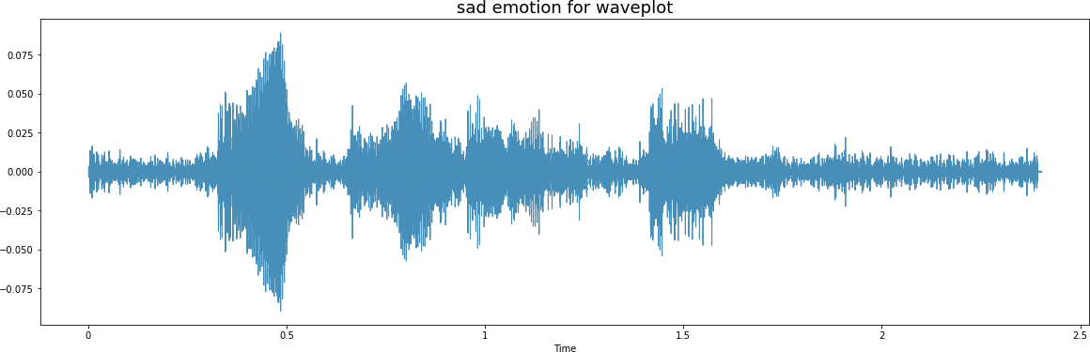
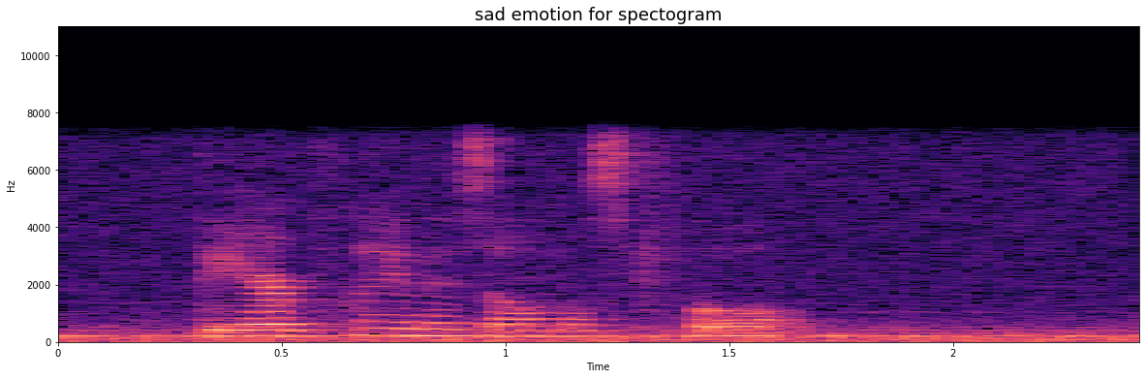
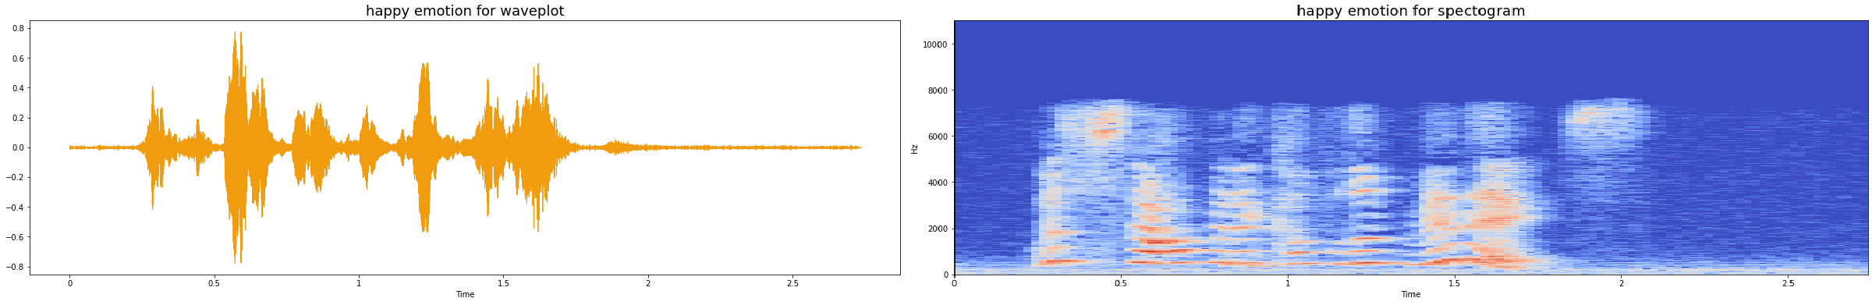
EDA – PART 5
WAVEPLOT AND SPECTOGRAM FOR EACH EMOTION

Slide 20
MAPPING SER WITH ML
Models: Below Models are used in Based conditions and Parameter Tuned Conditions
SVC
from sklearn.svm import SVC
MLP Classifier
from sklearn.neural_network import MLPClassifier
KNeighbors
from sklearn.neighbors import KNeighborsClassifier
CNN
Decision Tree
from sklearn.tree import DecisionTreeClassifier
Logistic Regression
from sklearn.linear_model import LogisticRegression

Slide 21
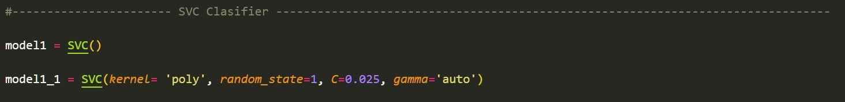
MAPPING SER WITH ML
SVC MODEL

Slide 22
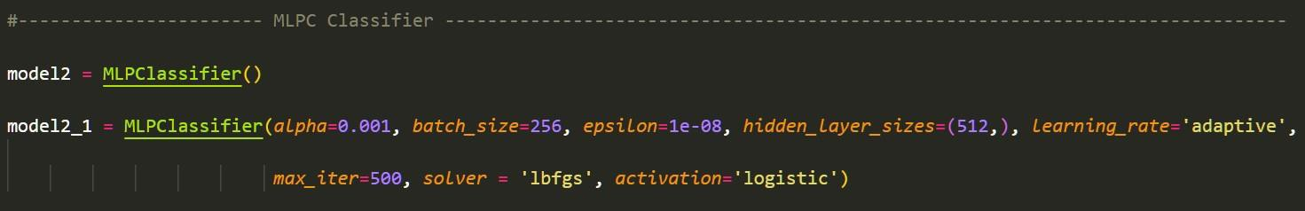
MAPPING SER WITH ML
MLPC MODEL

Slide 23
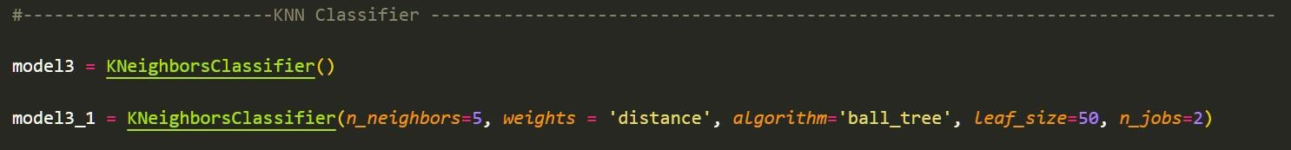
MAPPING SER WITH ML
KNN MODEL

Slide 24
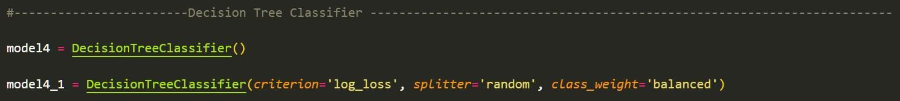
MAPPING SER WITH ML
DECISION TREE MODEL

Slide 25
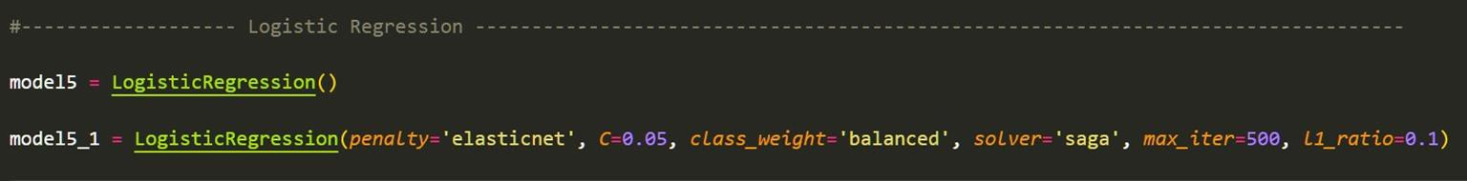
MAPPING SER WITH ML
LOGISTIC REGRESSION MODEL

Slide 26
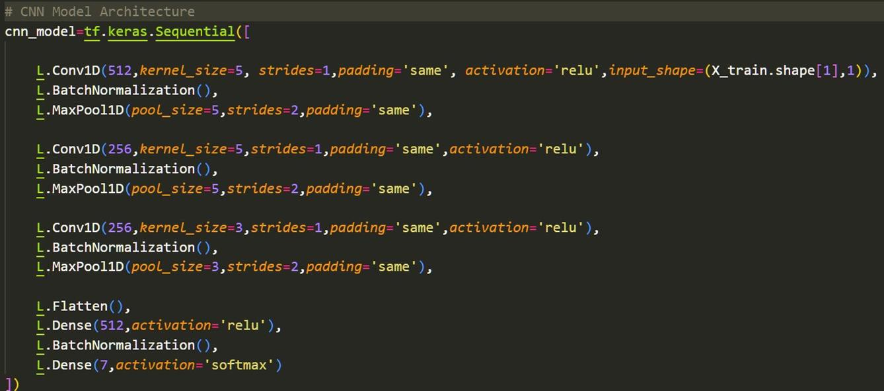
MAPPING SER WITH ML
CNN MODEL (TENSORFLOW)

Slide 27
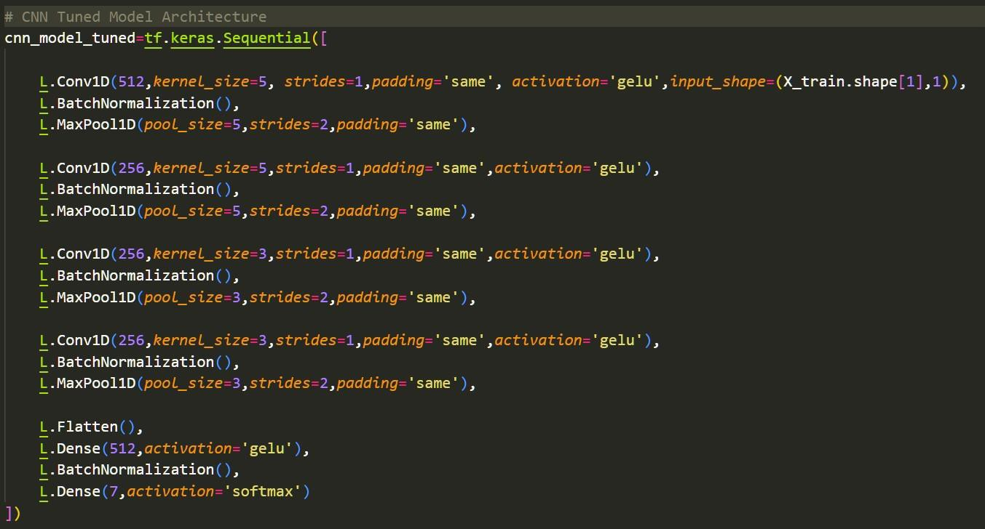
MAPPING SER WITH ML
CNN MODEL (TENSORFLOW)

Slide 28
EVALUATION METRICS
CONFUSION MATRIX:
It compares the actual and predicted classes of the data
CLASSIFICATION REPORT:
It provides the comparison of metric evaluated among different emotions for the data.
PRECISION |  | Precision is the ratio of correctly classified positive samples to total number of classified samples.
RECALL |  | Recall is the ability of a classifier to find all positive instances.
 | F-1 SCORE | The F1 score is a weighted harmonic mean of precision and recall.
ACCURACY |  | It is the number of correct predictions made divided by the total number of predictions.

Slide 29
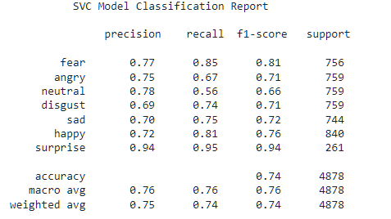
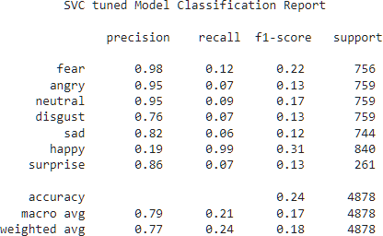
SVC MODEL CLASSIFICATION REPORT
SVC BASED MODEL | SVC TUNED MODEL

Slide 30
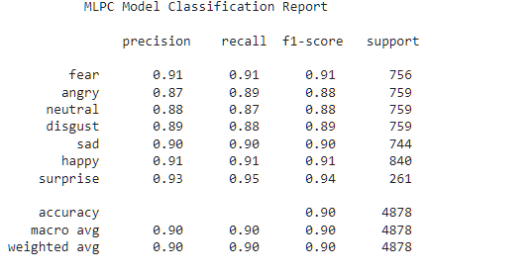
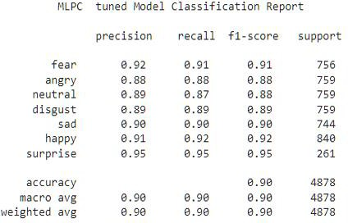
MLPC MODEL CLASSIFICATION REPORT
MLPC BASED MODEL | MLPC TUNED MODEL

Slide 31
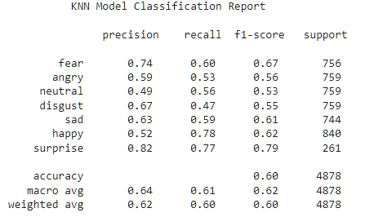
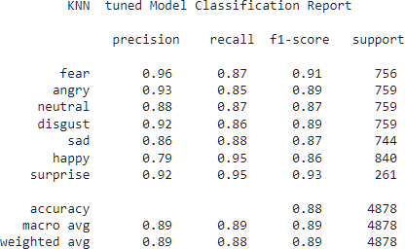
KNN MODEL CLASSIFICATION REPORT
KNN BASED MODEL | KNN TUNED MODEL

Slide 32
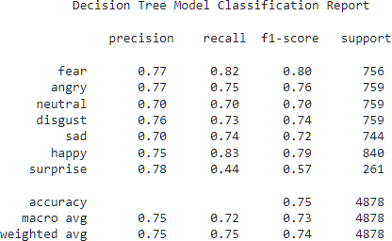
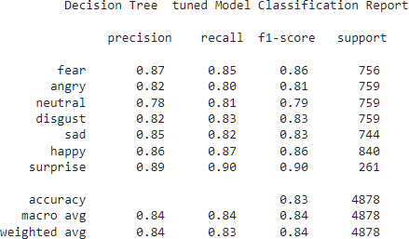
DECISION TREE MODEL CLASSIFICATION REPORT
DECISION TREE BASED MODEL | DECISION TREE TUNED MODEL

Slide 33
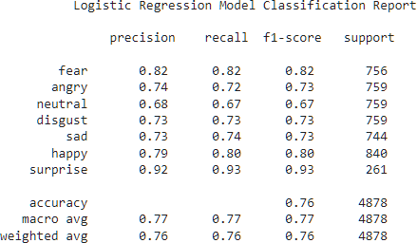
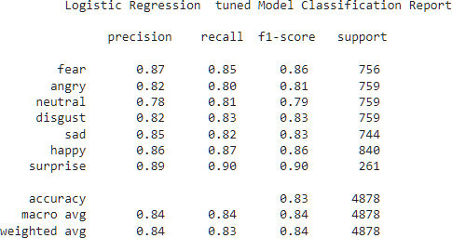
LOGISTIC REGRESSION CLASSIFICATION REPORT
LOGISTIC REGRESSION BASED MODEL | LOGISTIC REGRESSION TUNED MODEL

Slide 34
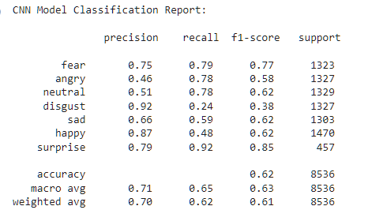
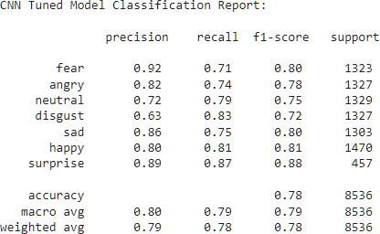
CNN MODEL CLASSIFICATION REPORT
CNN BASED MODEL | CNN TUNED MODEL

Slide 35
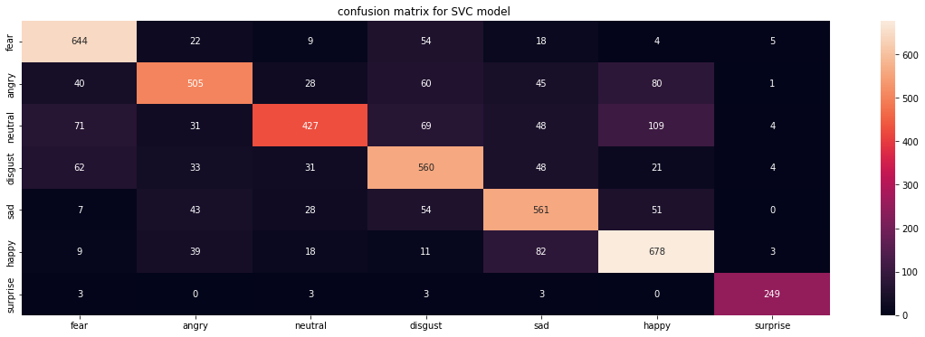
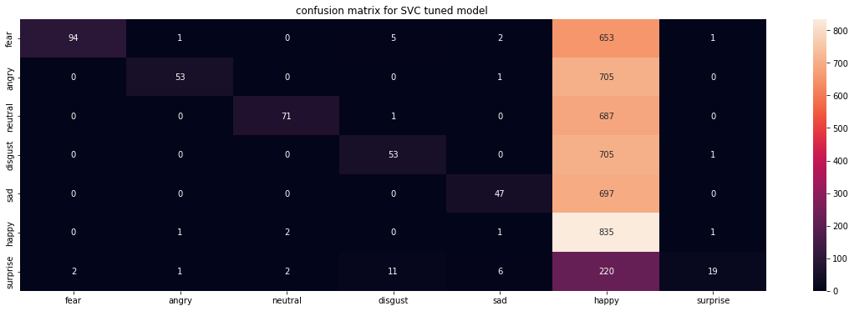
CONFUSION MATRIX FOR SVC MODEL
SVC BASED MODEL | SVC TUNED MODEL

Slide 36
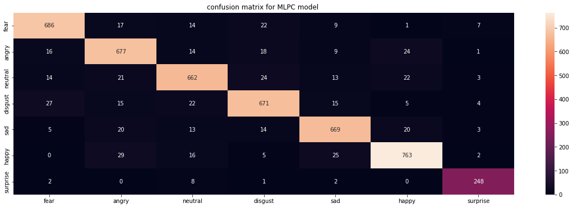
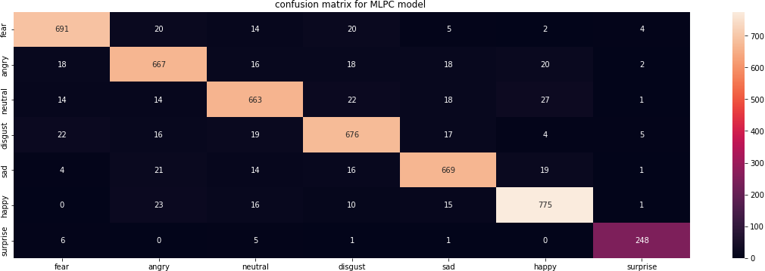
CONFUSION MATRIX FOR MLPC MODEL
MLPC BASED MODEL | MLPC TUNED MODEL

Slide 37
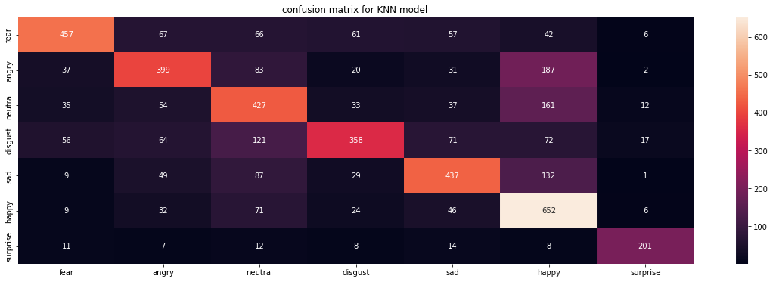
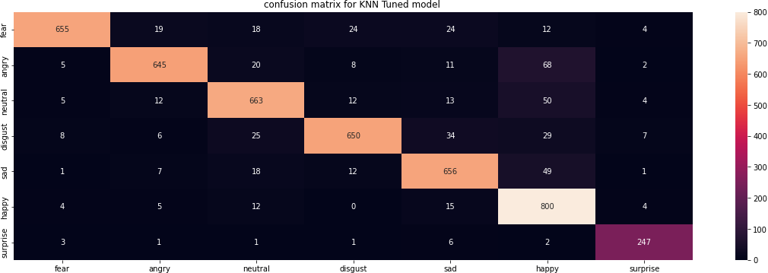
CONFUSION MATRIX FOR KNN MODEL
KNN BASED MODEL | KNN TUNED MODEL

Slide 38
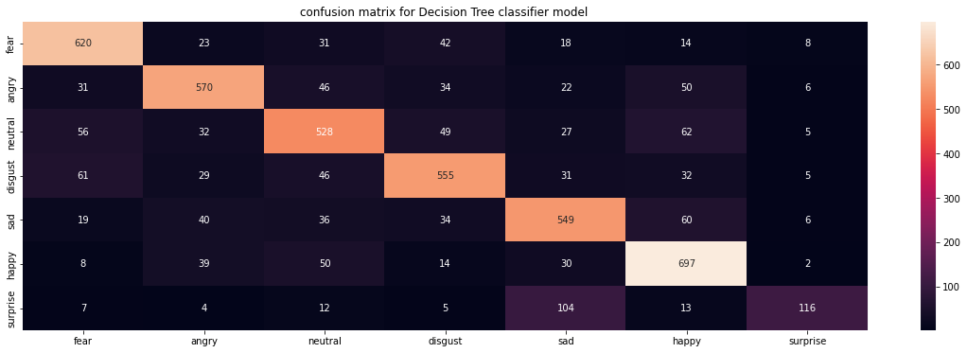
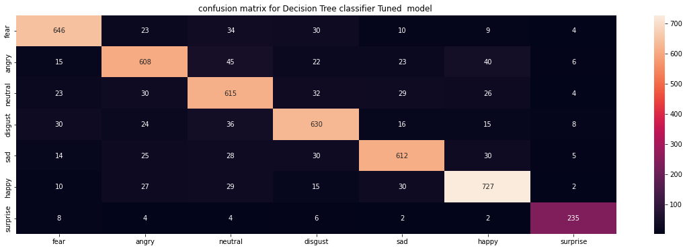
CONFUSION MATRIX FOR DECISION TREE MODEL
DECISION TREE BASED MODEL
DECISION TREE TUNED MODEL

Slide 39


CONFUSION MATRIX FOR LOGISTIC REGRESSION MODEL
LOGISTIC REGRESSION BASED
MODEL
LOGISTIC REGRESSION TUNED
MODEL

Slide 40


CONFUSION MATRIX FOR CNN MODEL
CNN BASED MODEL | CNN TUNED MODEL

Slide 41


ACCURACY SCORE METRICS
SVC MODEL | MLPC MODEL

Slide 42


ACCURACY SCORE METRICS
KNN MODEL | DECISION TREE MODEL

Slide 43


METRIC SCORES
LOGISTIC REGRESSION MODEL | CNN MODEL

Slide 44

METRIC SCORES

Slide 45


ACCURACY & LOSS AT EACH EPOCH FOR CNN
CNN BASE MODEL TRAINING AND
VALIDATION ACCURACY
CNN BASE MODEL TRAINING AND
VALIDATION LOSS

Slide 46


ACCURACY & LOSS AT EACH EPOCH FOR CNN
CNN TUNED MODEL TRAINING AND VALIDATION ACCURACY | CNN TUNED MODEL TRAINING AND VALIDATION LOSS

Slide 47
CONCLUSIONS
When the same audio information is conveyed in a variety of emotions, detecting emotion from audio rather than speech is quite useful.
Tone, rhythm, pitch, frequency, loudness, speed of sound, etc. are the major factors
that determine an auditory feature.
With the aid of advanced audio features like MFCC, RMS, ZCR, and Tonnetz, machine learning models may use the audio file to their advantage and anticipate emotions.
For model simulation, a variety of audio manipulation techniques can be employed to improve the audio's clarity, volume, and time characteristics like shifting and stretching.
Version one base models and version two parameter-tuned models of machine learning models are employed in this study. In certain instances, base models performed better than tuned models, although tuned models had a firm hold on neural network models.
For real-world scenarios in forecasts, accuracy scores of better than 80% are advised by model performance analysis.

Slide 48
BLOG LINK:
https://medium.com/@s157/speech- emotion-recognition-74f8878649a7
GITHUB LINK:
https://github.com/saran987/Speech- Emotion-Recognition-with-Audio

Slide 49
REFERENCES
Speech Emotion Recognition (akaike.ai)
Speech Emotion Recognition (SER) through Machine Learning (analyticsinsight.net)
Shengyun Wei et al 2020 J. Phys.: Conf. Ser. 1453 012085DOI 10.1088/1742-6596/1453/1/012085
Open Access proceedings Journal of Physics: Conference series (iop.org)
Parekh, R. (2012). Recognition of Isolated Words using Features based on LPC, MFCC, ZCR and STE, with Neural Network Classifiers (IJMER 2012). Int. Journal of Modern Engineering Research (IJMER). 2012_ijmer-with-cover-page-v2.pdf (d1wqtxts1xzle7.cloudfront.net)
Rawlinson, H., Segal, N., &amp; Fiala, J. (2015, January). Meyda: an audio feature extraction library for the web audio api. In The 1st web audio conference (WAC). Paris, Fr.
meyda-audio-feature-libre.pdf (d1wqtxts1xzle7.cloudfront.net)
Dashtipour, K., Gogate, M., Adeel, A., Larijani, H., &amp; Hussain, A. (2021). Sentiment analysis of persian
movie reviews using deep learning. Entropy, 23(5), 596.
Entropy | Free Full-Text | Sentiment Analysis of Persian Movie Reviews Using Deep Learning (mdpi.com)

Slide 50

THANKS !!
ANY QUESTION?

